Slide 1
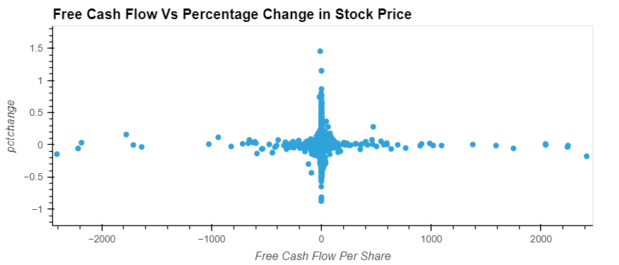
Data Exploration: Free Cash Flow Vs Percentage change in stock price
Free cash flow (FCF) represents the cash available for the company to repay creditors and pay out dividends and interest to investors. Because FCF accounts for changes in working capital, it provides important insight into the value of a company and the health of its fundamental trends. A decrease in accounts payable (outflow) could mean that vendors are requiring faster payment. A decrease in accounts receivable (inflow) could mean the company is collecting cash from its customers quicker. An increase in inventory (outflow) could indicate a building stockpile of unsold products.

Slide 2
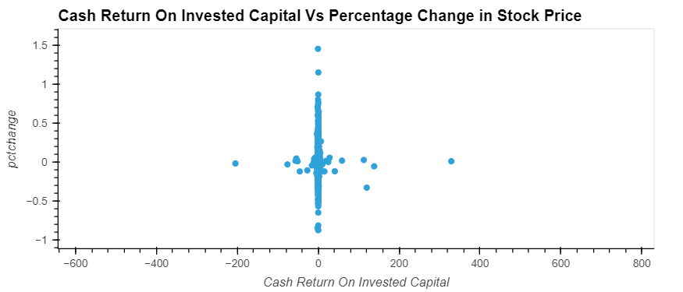
Data Exploration: Cash Return on Invested Capital Vs Percentage change in stock price
The Cash Return On Invested Capital, or CROIC, measures how effectively a company uses its Invested Capital to generate Cash. It is calculated as Free Cash Flow divided by Invested Capital. The higher the CROIC, the better and a CROIC above 10% is usually regarded as good.

Slide 3
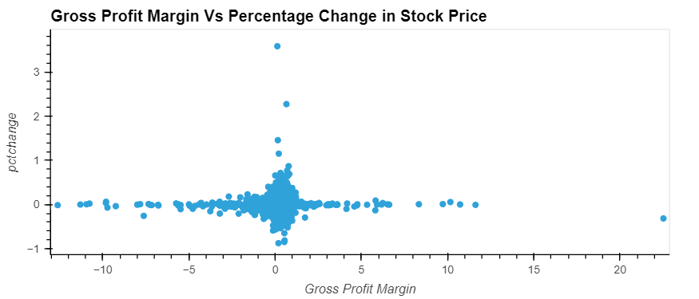
Data Exploration: Gross Profit Margin Vs Percentage change in stock price
Gross profit margin is expressed as a company's net sales minus the cost of goods sold (COGS). If a company's gross profit margin wildly fluctuates, this may signal poor management practices and/or inferior products.

Slide 4
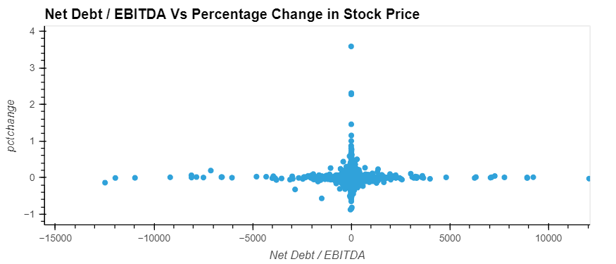
Data Exploration: Net Debt/EBITDA Vs Percentage change in stock price
The net debt-to-EBITDA ratio is a debt ratio that shows how many years it would take for a company to pay back its debt if net debt and EBITDA are held constant. Ratios higher than 4 or 5 typically set off alarm bells because this indicates that a company is less likely to be able to handle its debt burden, and thus is less likely to be able to take on the additional debt required to grow the business

Slide 5
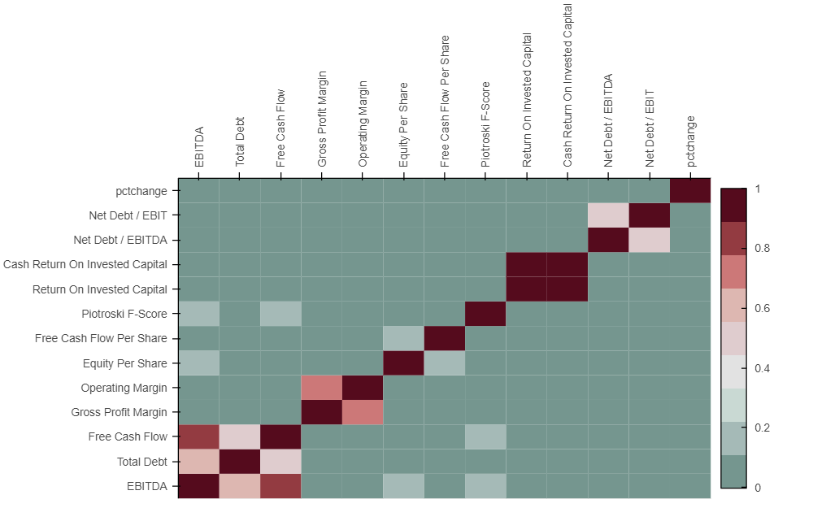
Data Exploration: Correlation Analysis
Individual financial metrics doesn't have any significant correlation with percentage change in stock price

